Slide 1
ASSISTED LIVING PROJECT
Ritwik Dutta

Slide 2
OVERVIEW OF CURRENT WORK
End user goes to the root website and clicks authorize
Frontend OAuth2 implementation flow redirects to Jawbone account login
Redirected temporary authentication token sent to server side Python CGI script
Script requests data from API by including Authentication tokens in the header
Script returns relevant data to JavaScript to be formatted and displayed

Slide 3
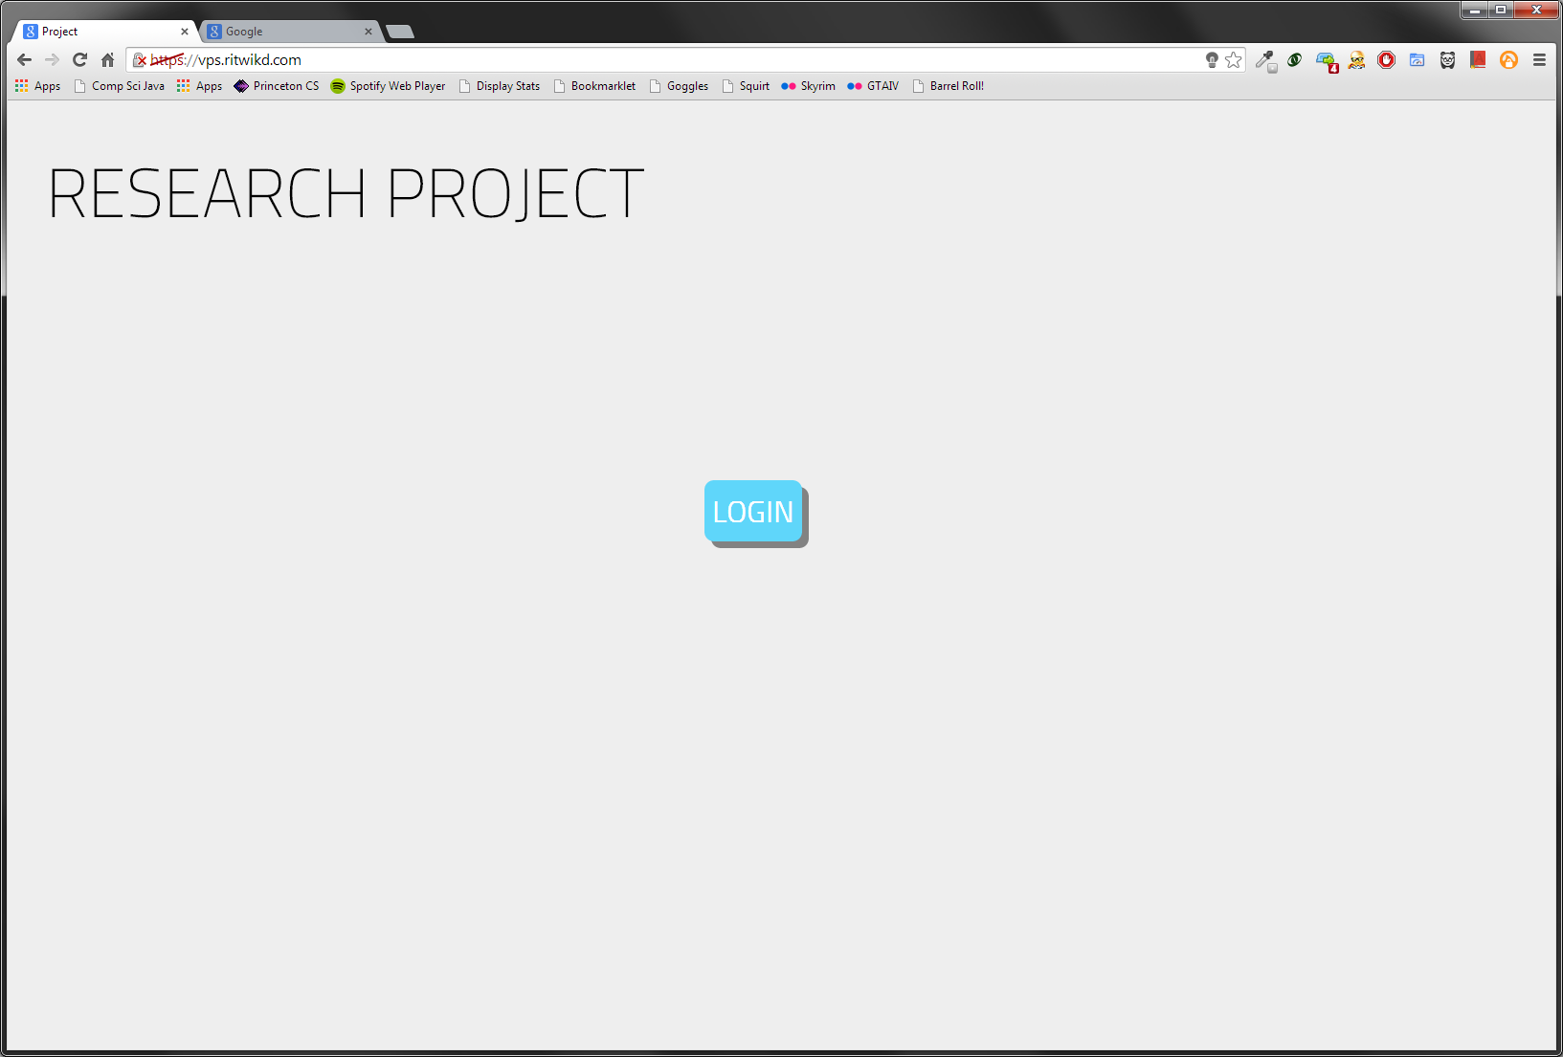
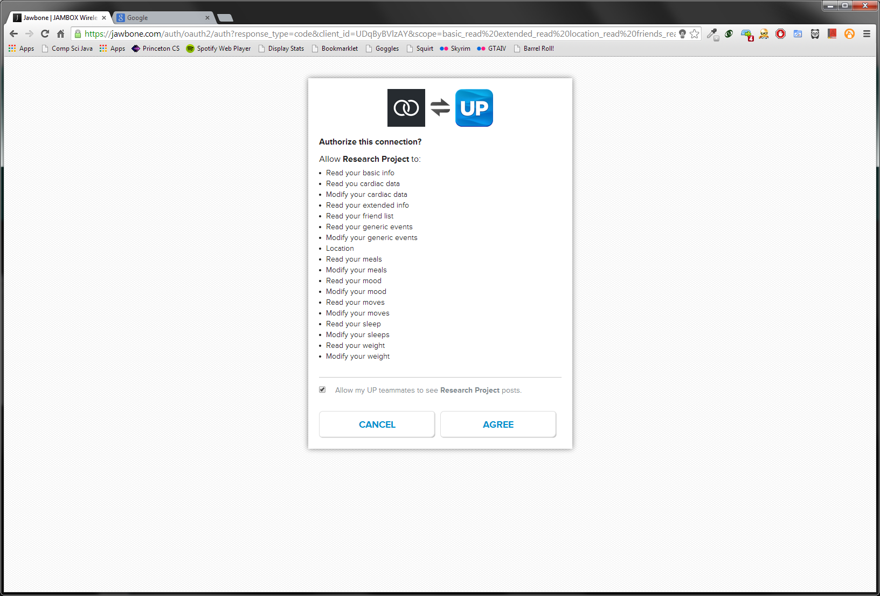

USER FLOW
AUTHORIZE
CONNECTION

